Slide 1

Comprehensive Analysis Stack Overflow(SQL)

Slide 2
Usama Bin Hafeez Abbasi
Production Analyst, Afiniti Pvt Ltd
Data Science Trainee, Atom Camp
usamahafeez.abbasi1234@gmail.com
https://github.com/usamaabbasi135

Slide 3
Introduction
Stack OverFlow Overview
Stack Overflow is a popular Q&A platform for developers.
The dataset includes tables like Users, Posts, Comments, Badges, Votes, etc.
Objectives
Explore user activity and engagement.
Analyze post quality and interactions.
Identify top users and their contributions.

Slide 4
Dataset Overview
Dataset Description
Users: Information about Stack Overflow users (e.g., reputation, badges).
Posts: Questions and answers posted by users.
Comments: Comments on posts.
Badges: Badges earned by users.
Votes: Votes on posts.
Post history: History of Post.
Post Links: Information about related posts.
Tags: Tags associated with posts.
Key Metrics
Total Users: 88,005 (Eighty-Eight Thousands and Five)
Total Posts: 68,495 (Sixty-Eight Thousands, Four Hundred and Ninety-Five)
Total Comments: 140,118 (One Lac, Forty Thousands, One Hundred and Eighteen Comments)
Total Badges: 131,097 (One Lac, Thirty-One Thousands, and Ninety-Seven Badges)

Slide 5
Data Exploration
Initial Exploration:
Explored the first 10 rows of each table to understand the structure.
Filtered posts with more than 2 comments. We have total 21,214 posts having more than 2 comments.
Displayed comments made in 2012, sorted by creation date.
Key Findings:
Average post score by post type: Average scores were 3.2 and 4 for Post Types having id as 1 and 2.
Total number of badges: One Lac Thirty-One Thousands and Ninety-Seven Badges were obtained by users.

Slide 6
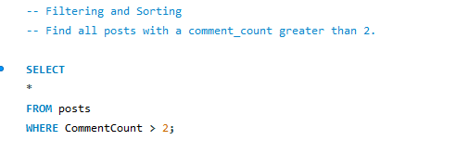
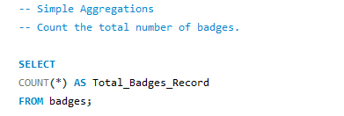

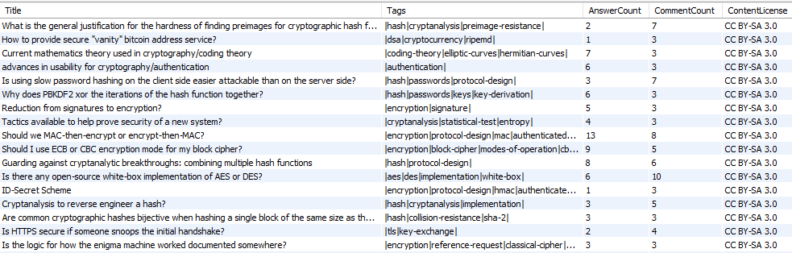
Queries Used

Slide 7
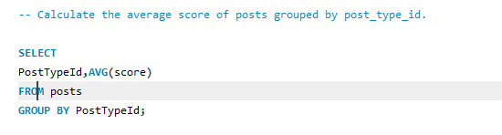
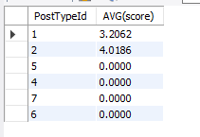
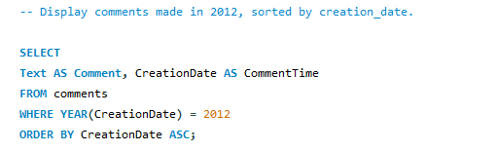
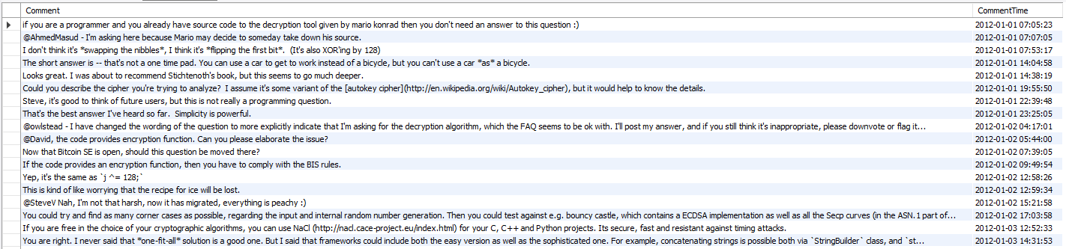
Queries Used

Slide 8
Joins and Relationships
Table Relationships:
Users can have multiple badges, posts, and comments.
Posts can have multiple comments and votes.
Key Insights:
Combined post history and posts to track changes in posts.
Joined users and badges to find total badges earned by each user.
Fetched post titles, comments, and users who made those comments.

Slide 9
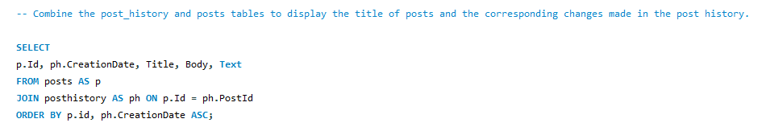
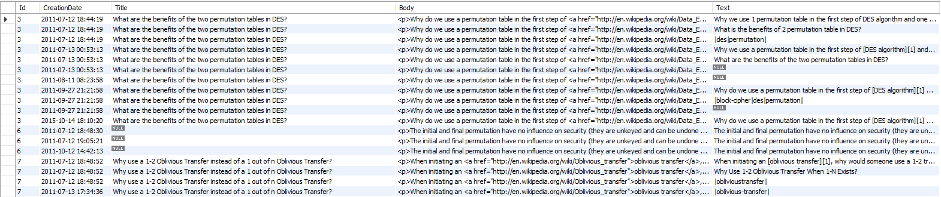
Queries Used

Slide 10
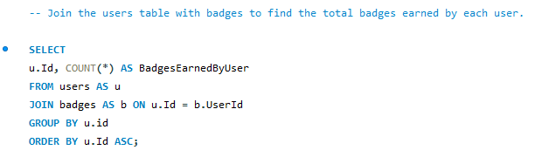
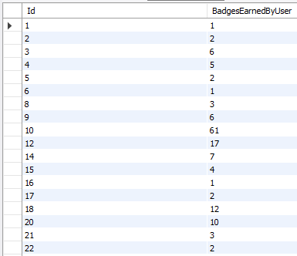
Queries Used

Slide 11
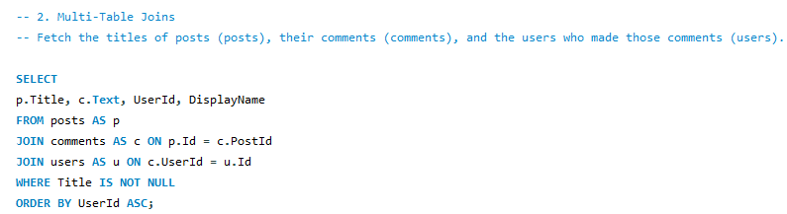
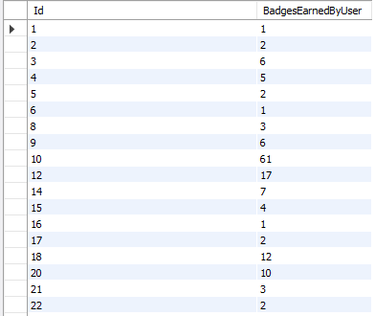
Queries Used

Slide 12
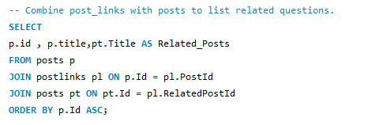
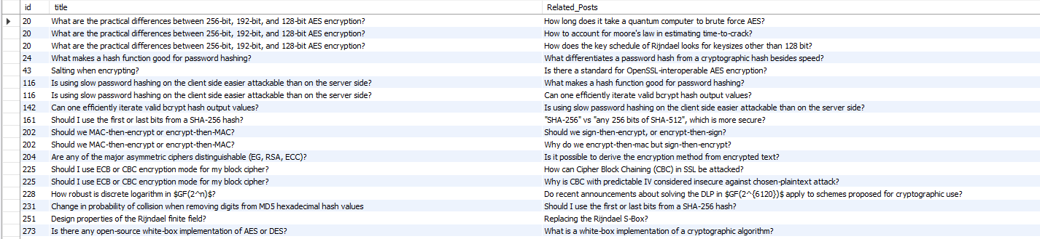
Queries Used

Slide 13
Advanced Analysis
Subqueries and CTEs:
Found the user with the highest reputation.
Retrieved posts with the highest score in each post type.
Recursive CTEs:
Simulated a hierarchy of linked posts using recursive CTEs.
Ranking and Running Totals:
Ranked posts based on their score within each year.
Calculated the running total of badges earned by users.

Slide 14
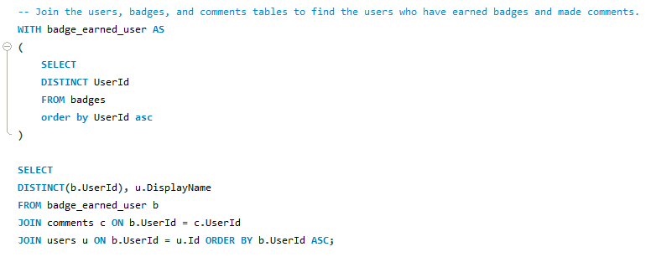
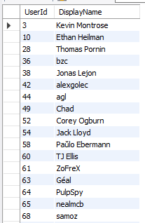
Queries Used

Slide 15
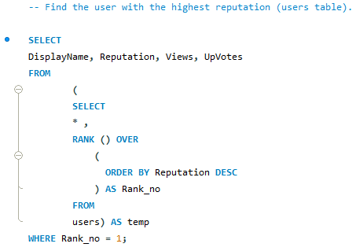

Queries Used

Slide 16
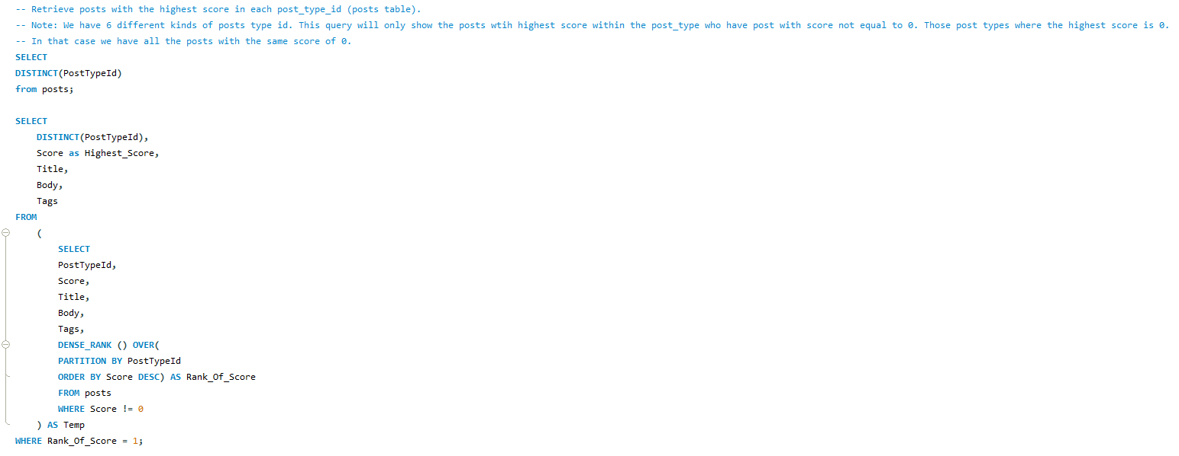
Queries Used

Slide 17
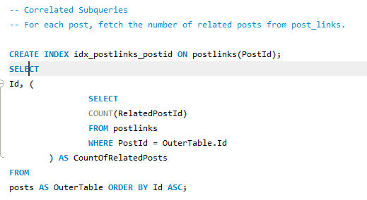
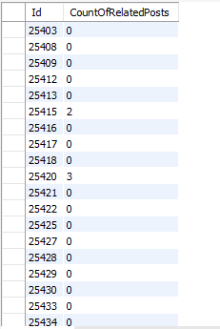
Queries Used

Slide 18
Queries Used

Slide 19
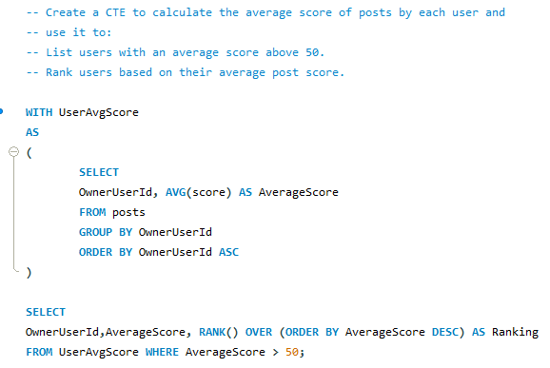
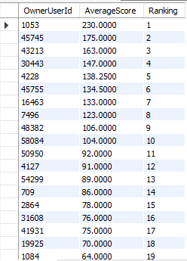
Queries Used

Slide 20
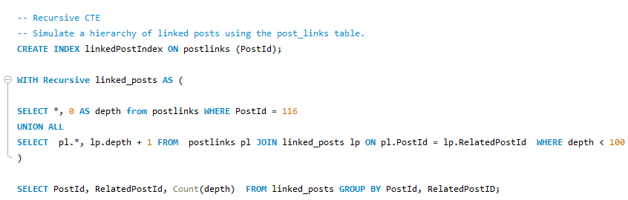
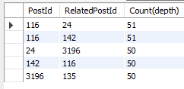
Queries Used

Slide 21
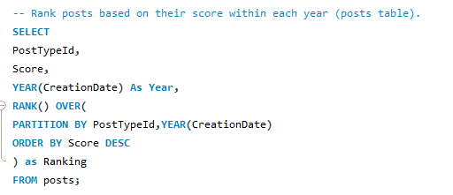
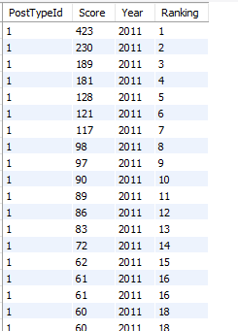
Queries Used

Slide 22
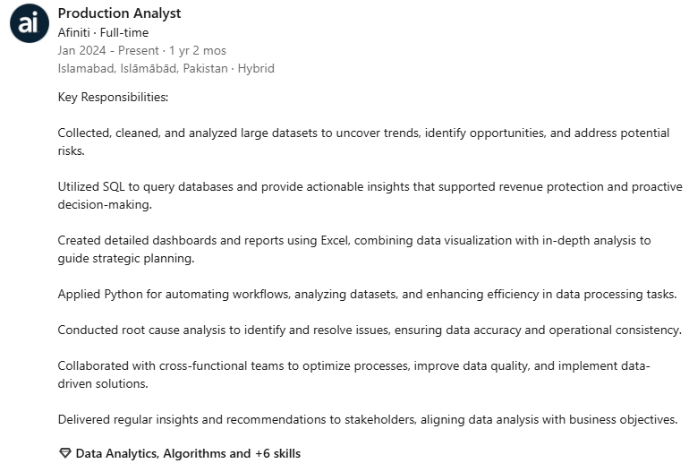
Thank you
Usama Bin Hafeez Abbasi
0334-5259239
Usamahafeez.abbasi@afiniti.com
https://github.com/usamaabbasi135

